Slide 1
Week 3 & 4
DSC 640
Abed Tabbalat

Slide 2
Python

Slide 3

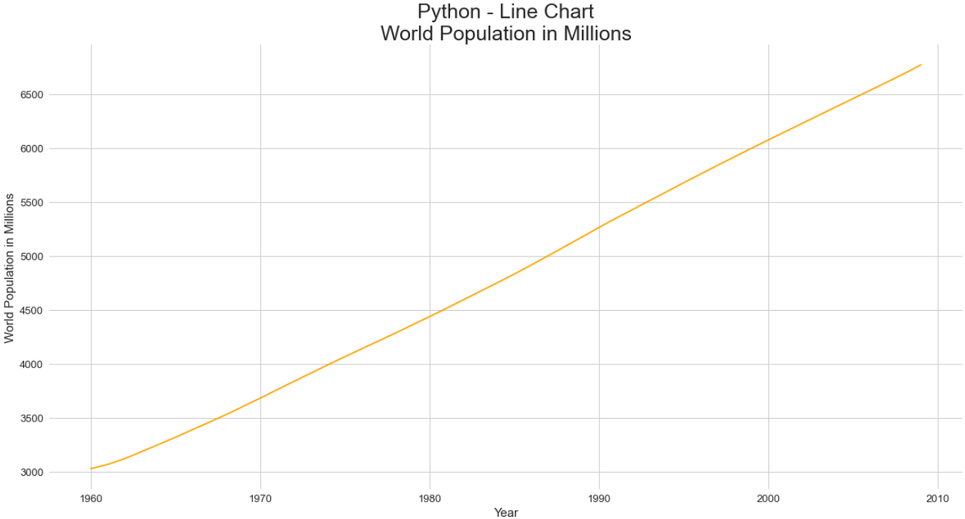
Python – line Chart

Slide 4
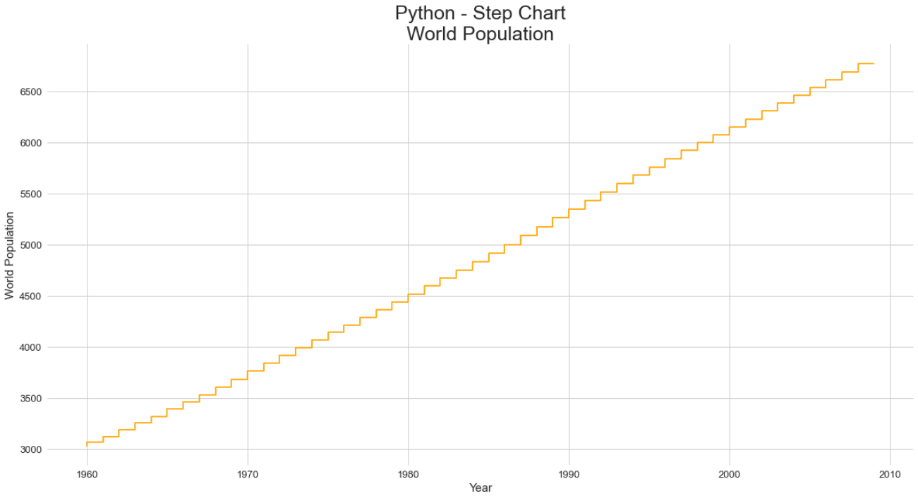
Python – step Chart

Slide 5
R

Slide 6
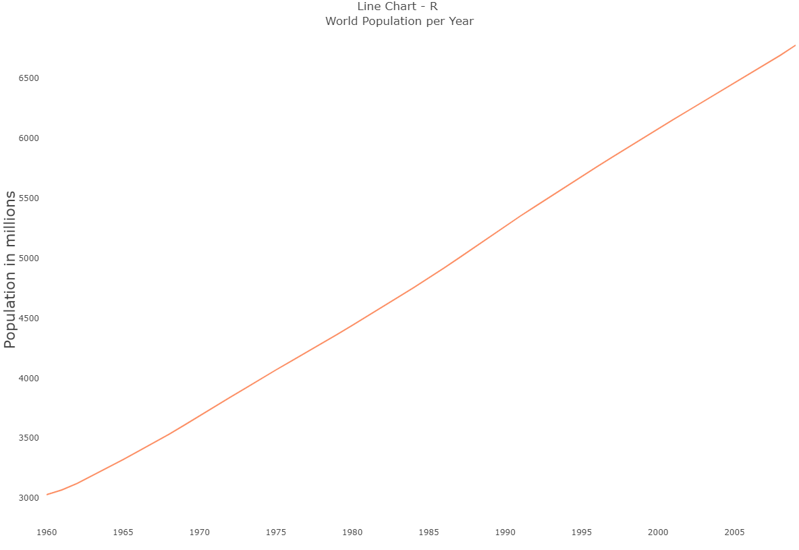
R – line Chart

Slide 7
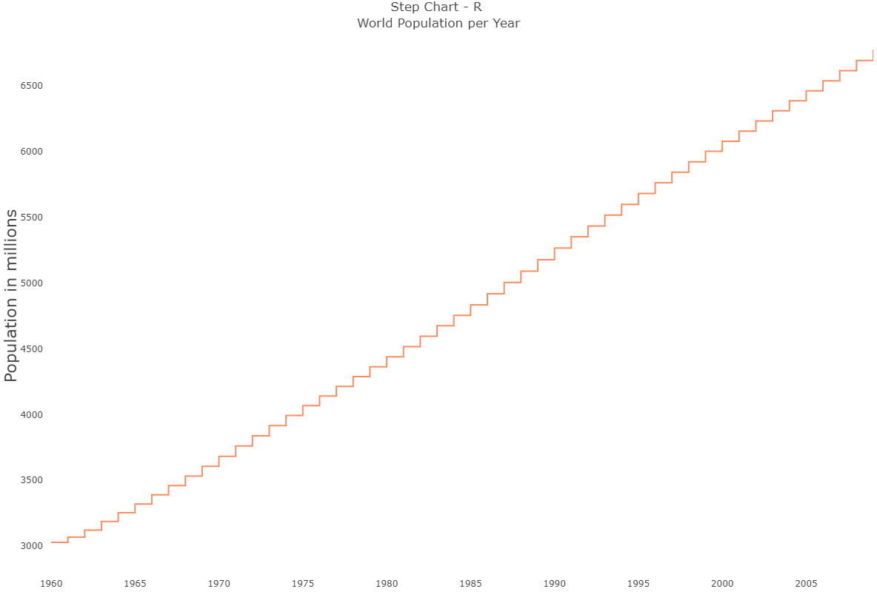
r – step Chart

Slide 8
Tableau

Slide 9
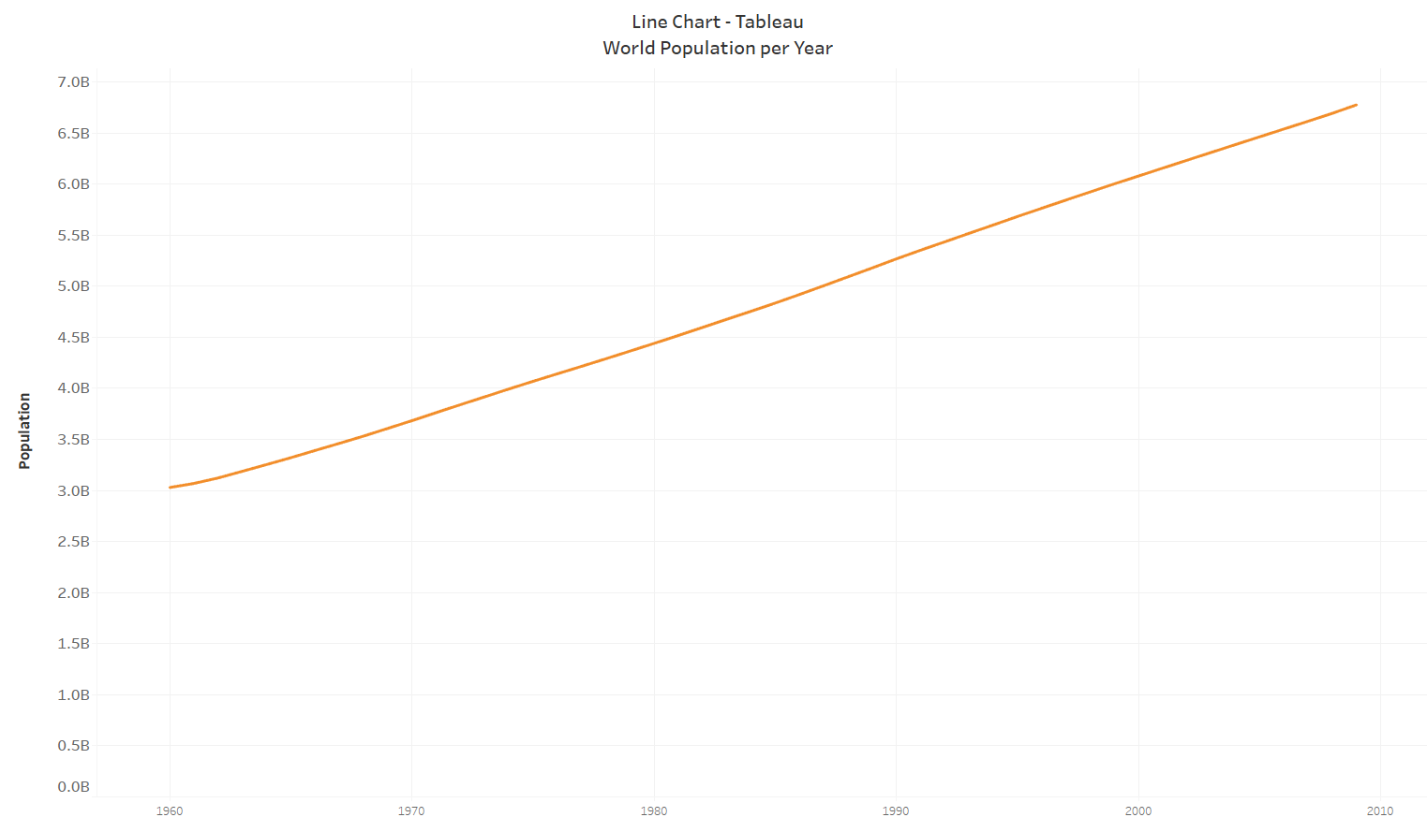
Tableau – line Chart

Slide 10
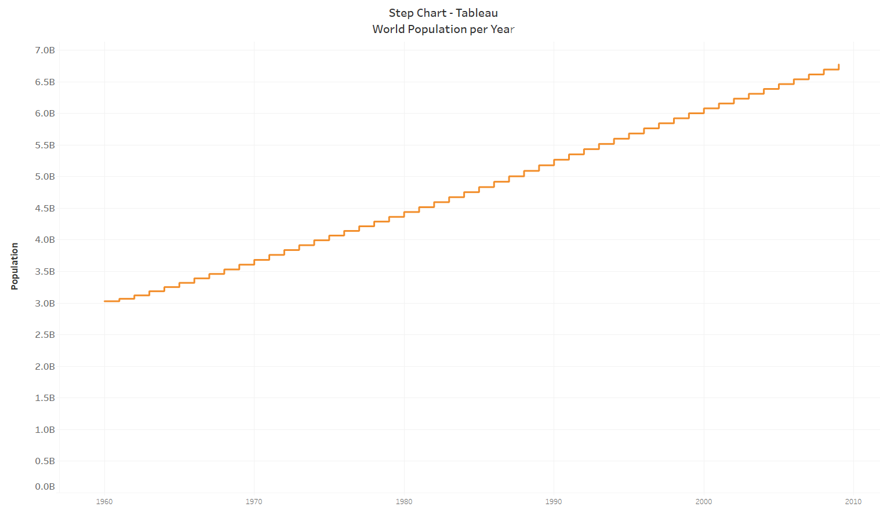
Tableau – step Chart

